Slide 1

G I V I N G R O O T S
S Y S T E M C O N C E P E C T S A N D A N A L Y S I S

Slide 2
G R O U P - 8
01 Sakshi Desai-8995937
₀₂ Naveed Khan-8913095
03 Sufiyan Shaikh-8991907

Slide 3
What is GivingRoots?
A comprehensive platform tailored for Canadian nonprofits to manage donations, volunteers, and donor relationships—all in one place.
Key Differentiators:
Bilingual (English/French) support Volunteer and donation tools under one roof Affordable, user-friendly, secure
Core Components:
Donation Processing System CRM & Donor Management
Volunteer Scheduling and Tracking Analytics Dashboard
Admin Panel & User Portal
Payment Gateway Integration (Stripe/PayPal)
Data Flow: Visual representation of users interacting with frontend → backend services → database and third-party APIs.

Slide 4
Key Features
Donation Management:--Recurring, one-time, and peer-to-peer donations Volunteer Coordination:--Scheduling, tracking, and notifications
Donor CRM:-- View history, engagement, and automated thank-you notes Bilingual Interface:--Switch between English and French
Custom Reports:--Insights into donor behavior and campaign success Secure Transactions:--Encryption, and fraud alerts
User Roles & Actors
Donors: Individuals contributing to causes
Nonprofit Admins: Manage campaigns, donations, and volunteers Volunteers: Sign up and log hours
GivingRoots Admin: Oversee platform functionality and compliance Third-party Services: Payment gateways, utility integrations
Future Enhancements
AI-Powered Donor Insights: Predictive analytics for donor retention Blockchain Donations: Transparent and traceable donations
Mobile App: Native iOS/Android version for on-the-go access Integration with CRA: Streamlined tax receipting

Slide 5
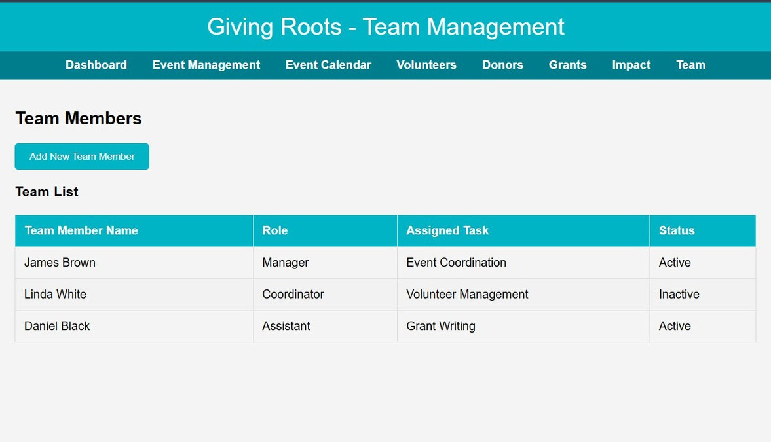
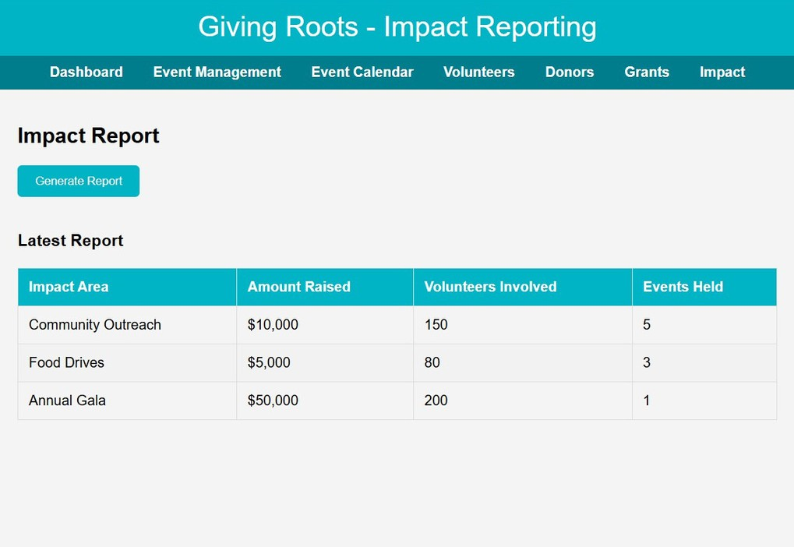
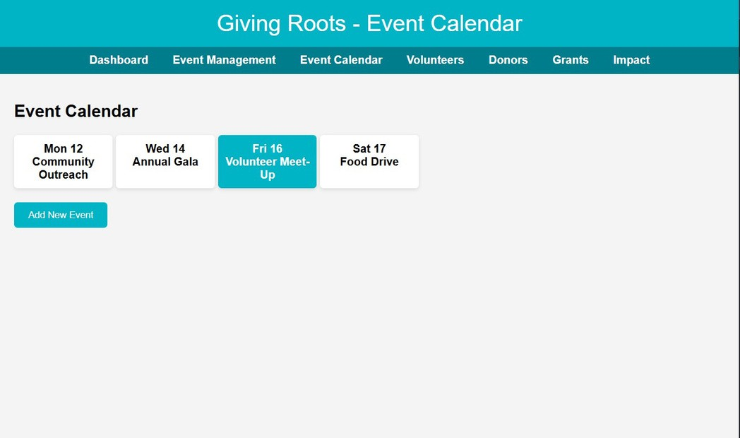
Mock Designs:-

Slide 6
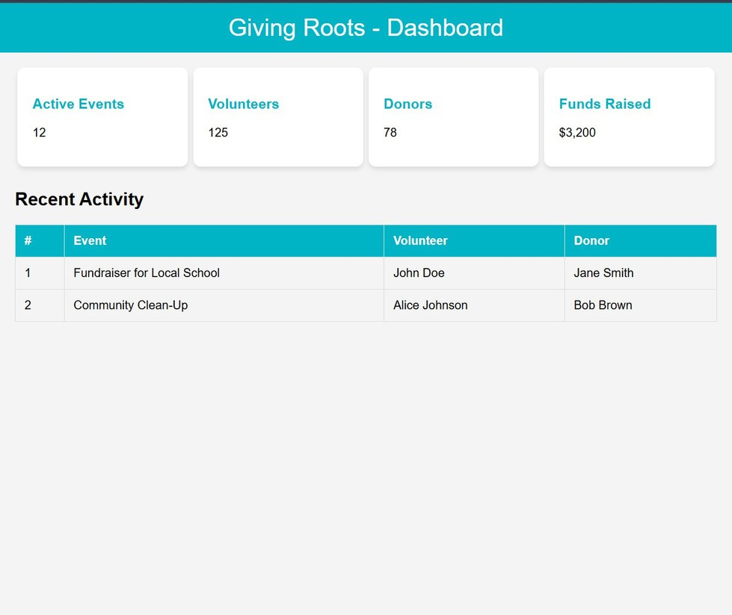
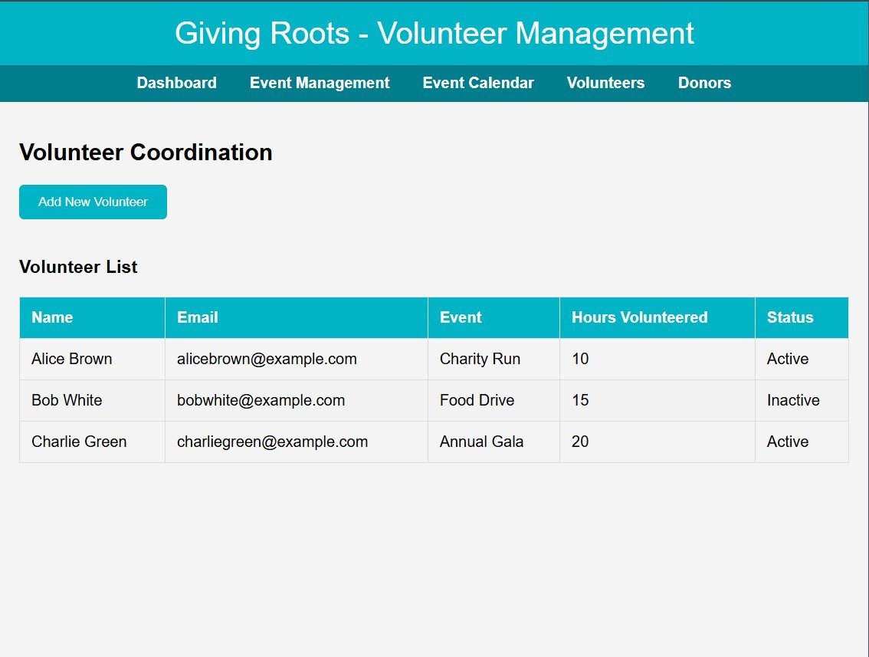

Slide 7
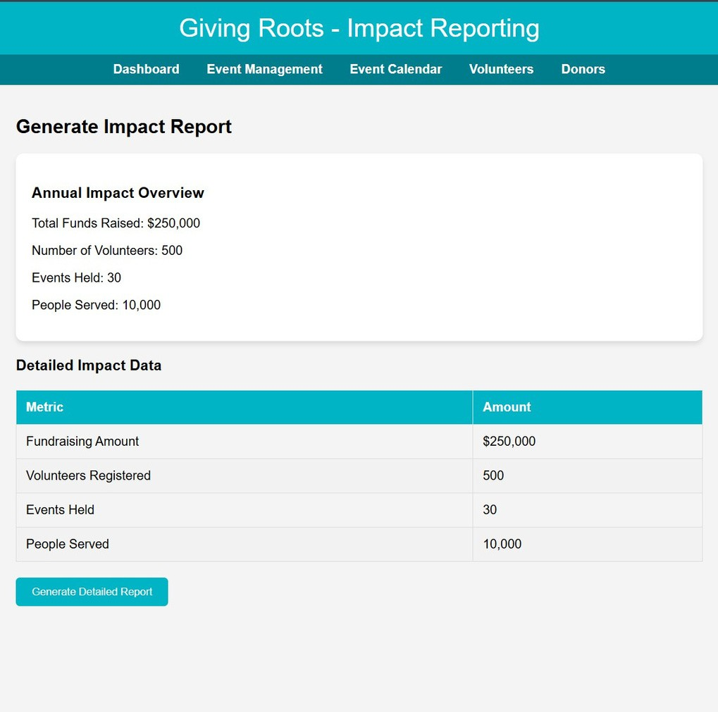
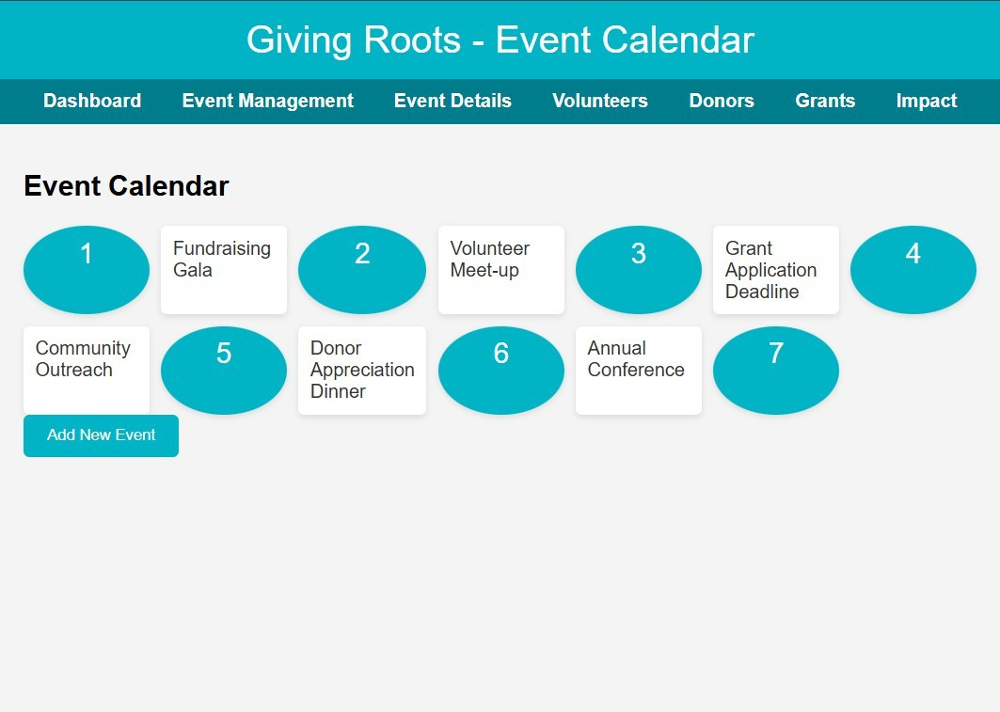

Slide 8
Major Use Case:
Online Donation Management
Goal: Allow users to donate securely and view the Online Donation Management Goal: Allow users to donate securely and view the impact of their contributions.
Actors: Donor, GivingRoots, Payment Gateway Flow Summary:
Donor logs in and chooses a campaign
Enters amount and selects payment method
Confirms donation
Receives receipt and impact dashboard
Value Delivered: Fast, secure, meaningful giving experience mpact of their contributions.
Actors: Donor, GivingRoots, Payment Gateway Flow Summary:
Donor logs in and chooses a campaign Enters amount and selects payment method Confirms donation
Receives receipt and impact dashboard
Value Delivered: Fast, secure, meaningful giving experience

Slide 9
Use Case
Actor(s)
Purpose
Donor Profile & History
Donor
View past donations, receipts, and impact
Nonprofit Admin
Admin Dashboard
Track donations, volunteers, and metrics
Nonprofit Admin
Campaign Creation & Management
Launch and manage fundraising campaigns
Bilingual Communication
All Users
Access platform in English or French
Secure Authentication
All Users
Protect accounts via 2FA or biometrics
Recurring Donations Setup
Donor
Automate regular giving with custom frequency
Refund Request
Donor, Admin
Dispute handling with notifications
Rewards & Recognition
Donor
Points or badges for recurring contributions
Nonprofit Admin
CRM Tools
Personalized outreach and segmentation
Analytics & Reporting
Admin, Staff
Exportable insights for decision-making

Slide 10
GivingRoots is more than just an app—it’s a data-driven nonprofit platform that embodies the principles of efficient system design, secure information processing, and user-centered innovation.
Through automation, analytics, and accessibility, it empowers Canadian nonprofits to make smarter decisions, deepen engagement, and scale their impact sustainably.
Thank You Group-8

